Slide 1
Welcome

Slide 2
List

Slide 3
List types

Slide 4
Single-line List
Ex; Contact
Notes:
Contact

Slide 5
Two-line List Ex; Shopping cart

Slide 6
Three-line List Ex; Mail Inbox

Slide 7
List controls

Slide 8
List controls
Display information and actions for the list items.

Slide 9
Checkbox

Slide 10
Expand and collapse

Slide 11
Expand and collapse

Slide 12
Expand and collapse

Slide 13
Expand and collapse

Slide 14
Switch

Slide 15
Switch

Slide 16
Switch
Reorder

Slide 17
Switch
Reorder

Slide 18
List in Android

Slide 19
List in Android
ListView

Slide 20
ListView
Attempts to reuse view objects in order to improve performance and avoid a lag in response to user scrolls.

Slide 21
Pros
Cons

Slide 22
Pros
Cons
Easy to implement

Slide 23
Pros
Cons
Vertical list only
Easy to implement

Slide 24
Pros
Cons
Vertical list only
Complicated with ViewHolder
Easy to implement

Slide 25
Pros
Cons
Vertical list only
Complicated with ViewHolder
Bad performance (Huge list of items)
Easy to implement

Slide 26
ListView

Slide 27
ListView

Slide 28
Why not recommended

Slide 29
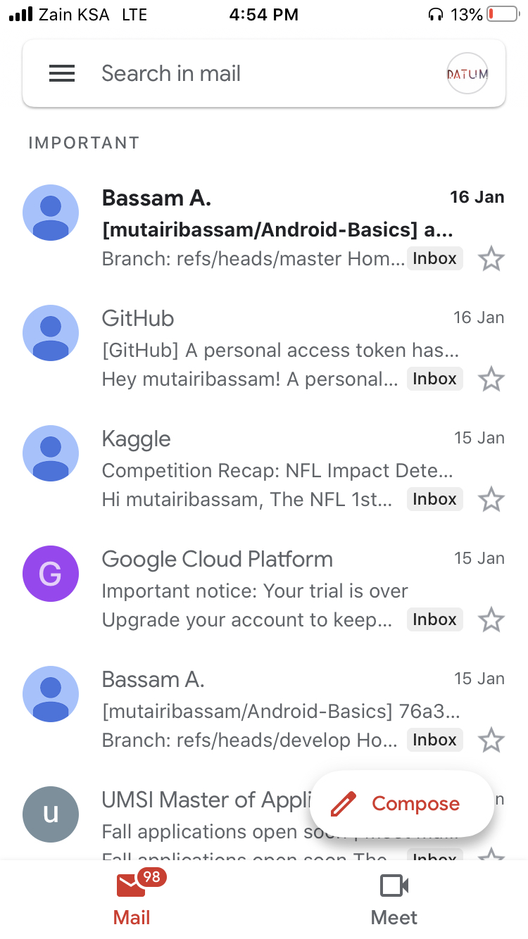
Why not recommended

Slide 30
RecyclerView

Slide 31
Pros
Cons

Slide 32
Pros
Cons
Support Animation

Slide 33
Pros
Cons
Support Animation
Support different presentations Ex; Linear – Grid – Staggered

Slide 34
Pros
Cons
Support Animation
Support different presentations
High performance

Slide 35
Pros
Cons
Support Animation
Support different presentations
High performance

Slide 36
Pros
Cons
Support Animation
Support different presentations
Good performance
Not easy to implement

Slide 37
Pros
Cons
Support Animation
Support different presentations
Good performance
Not easy to implement
For the first time

Slide 38
Pros
Cons
Not easy to implement for the first time
Support Animation
Support different presentations
Good performance
Requires ViewHolder Design Pattern

Slide 39
RecyclerView
Coding part

Slide 40
Step 1
Add dependency

Slide 41
Step 1
Add dependency

Slide 42
Step 2
Add RecyclerView element in the layout

Slide 43
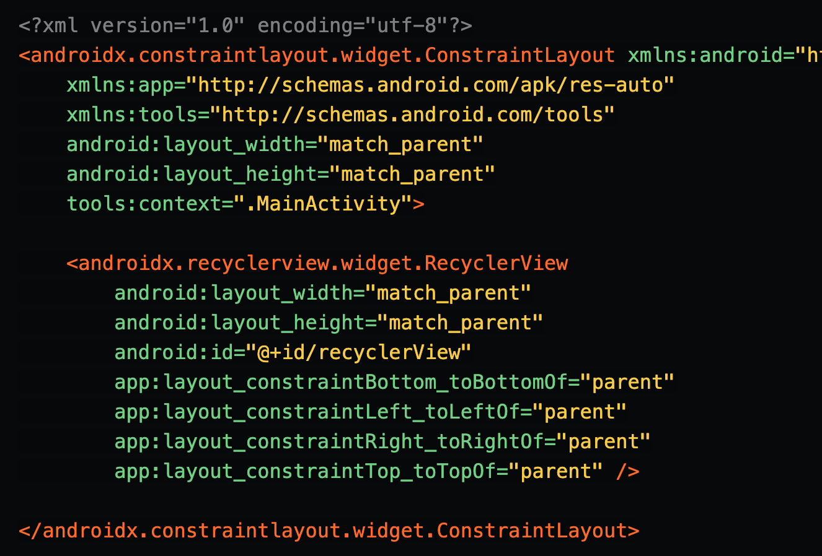
Step 2
Add RecyclerView element in the layout

Slide 44
Step 3
Prepare the layout

Slide 45
Step 3
Data
Prepare the layout

Slide 46
Step 3
Data
Source
Prepare the layout

Slide 47
Step 3
User Actions
Data
Source
Prepare the layout

Slide 48
Step 3
User Actions
Data
Source
List type
Prepare the layout

Slide 49
Step 3
Prepare the layout

Slide 50
Step 4
Prepare Model Class

Slide 51
Step 4
Prepare Model Class
Used to model the data in the application.

Slide 52
Step 4
Prepare Model Class
Used to model the data in the application. Why?

Slide 53
Step 4
Prepare Model Class
Used to model the data in the application. Why?
To send and receive data.

Slide 54
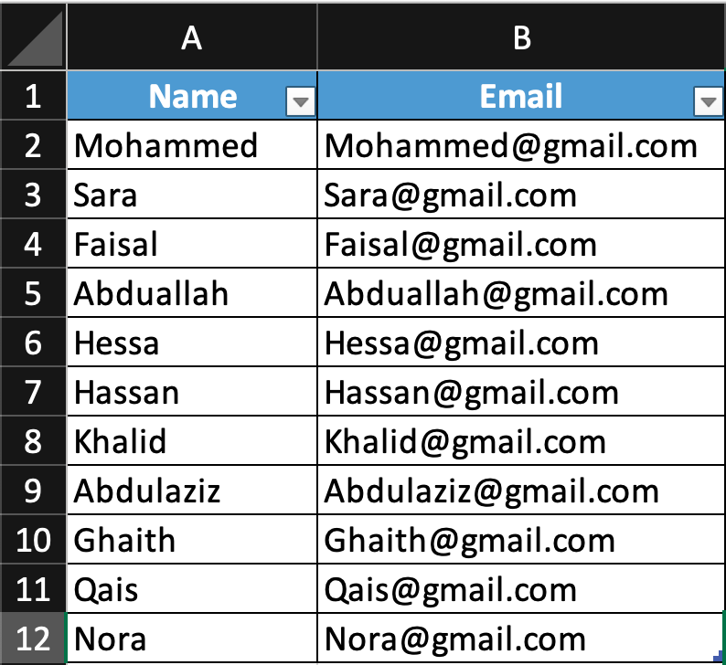
Step 4

Slide 55
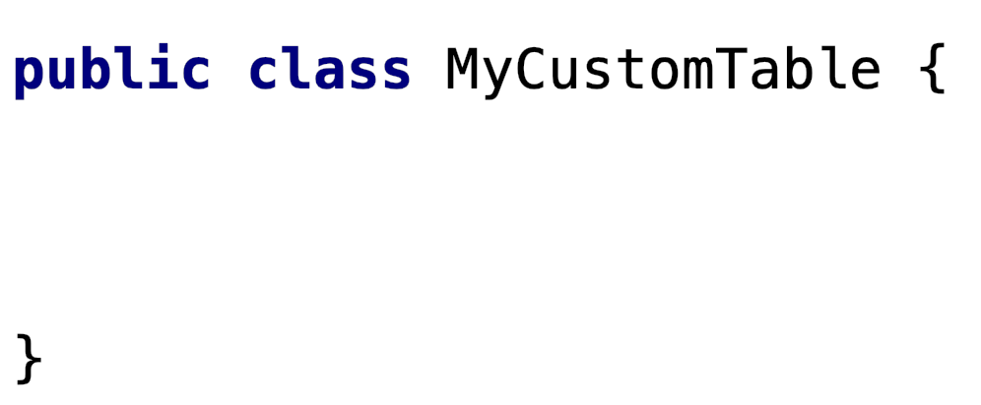
Step 4

Slide 56
Step 4

Slide 57
Step 4

Slide 58
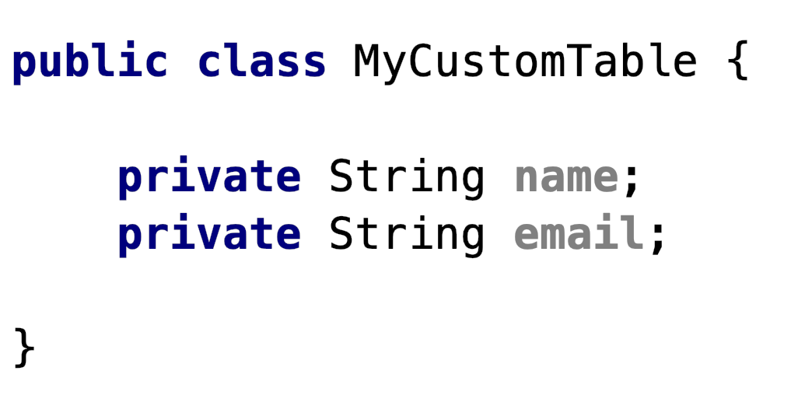
Step 4

Slide 59
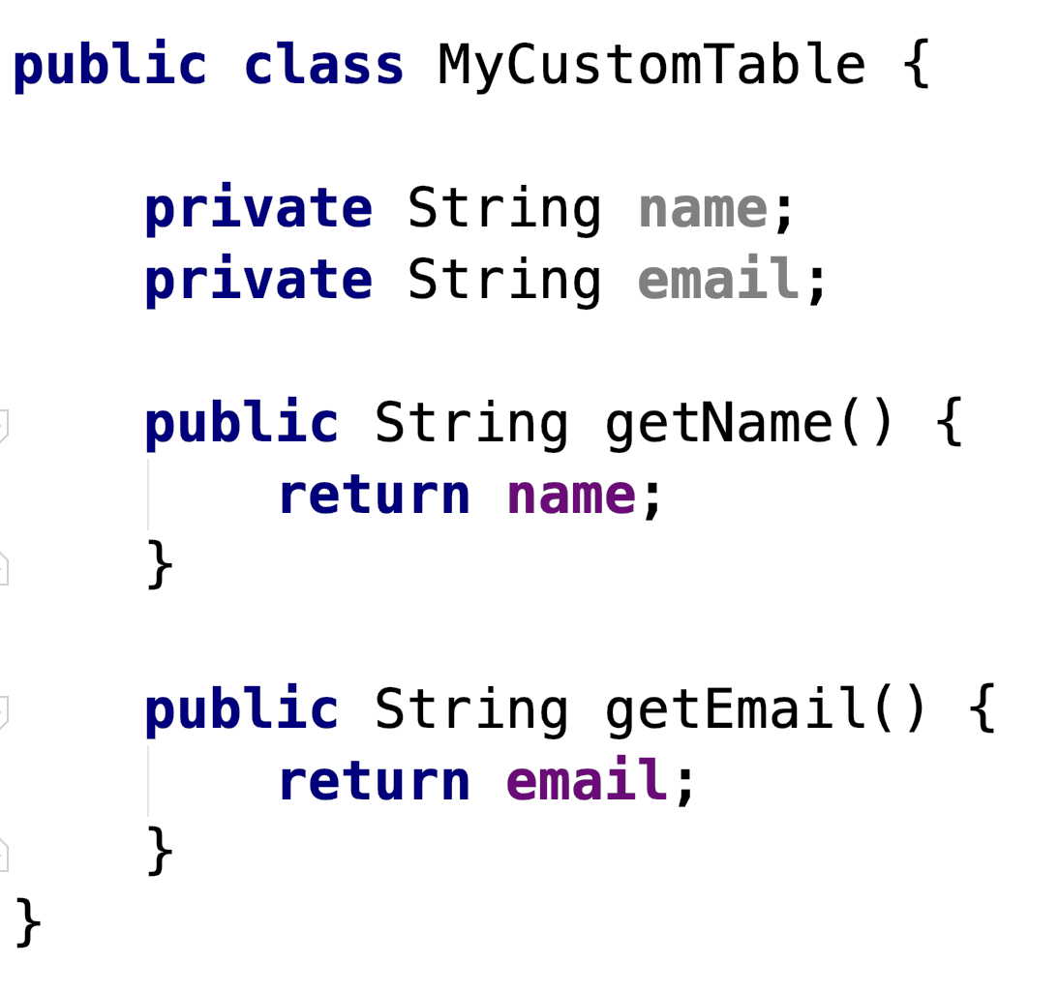
Step 4

Slide 60
Step 4

Slide 61
Step 4

Slide 62
Step 5
Prepare RecyclerView Adapter

Slide 63
Step 5
What is RecyclerView Adapter?

Slide 64
Step 5
What is RecyclerView Adapter?
A class that connects our data with the RecyclerView

Slide 65
RecyclerView Adapter
Create a new class

Slide 66
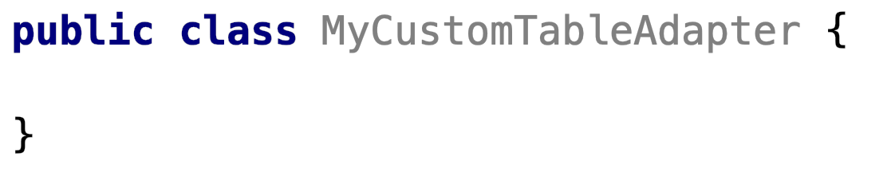
RecyclerView Adapter
Steps
Create a new class

Slide 67
RecyclerView Adapter
Steps
Create a new class
The class needs to extend the Adapter

Slide 68
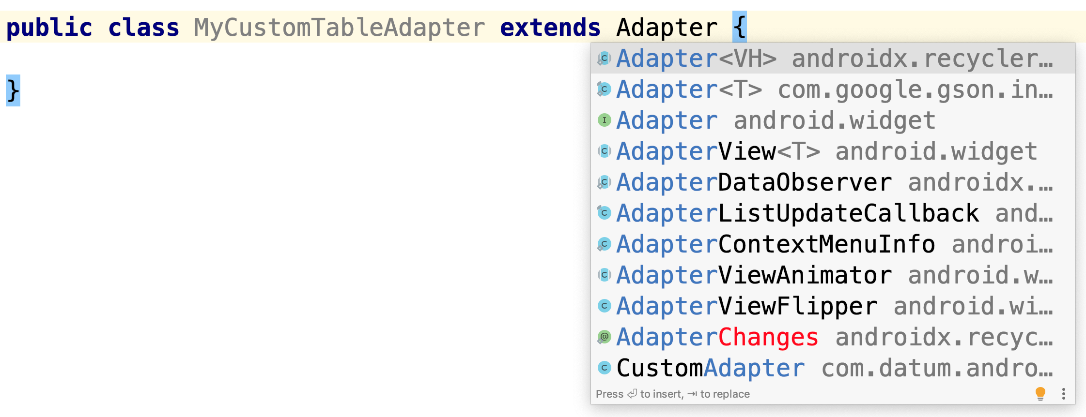
Steps
Create a new class
The class needs to extend the Adapter
RecyclerView Adapter

Slide 69
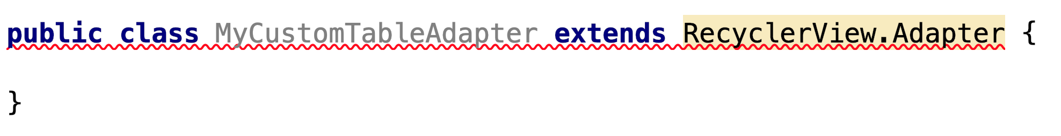
Steps
Create a new class
The class needs to extend the Adapter
RecyclerView Adapter

Slide 70
Steps
Create a new class
The class needs to extend the Adapter
RecyclerView Adapter
Error??

Slide 71
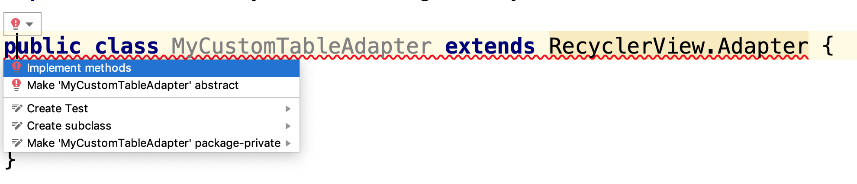
Steps
Create a new class
The class needs to extend the Adapter
RecyclerView Adapter

Slide 72
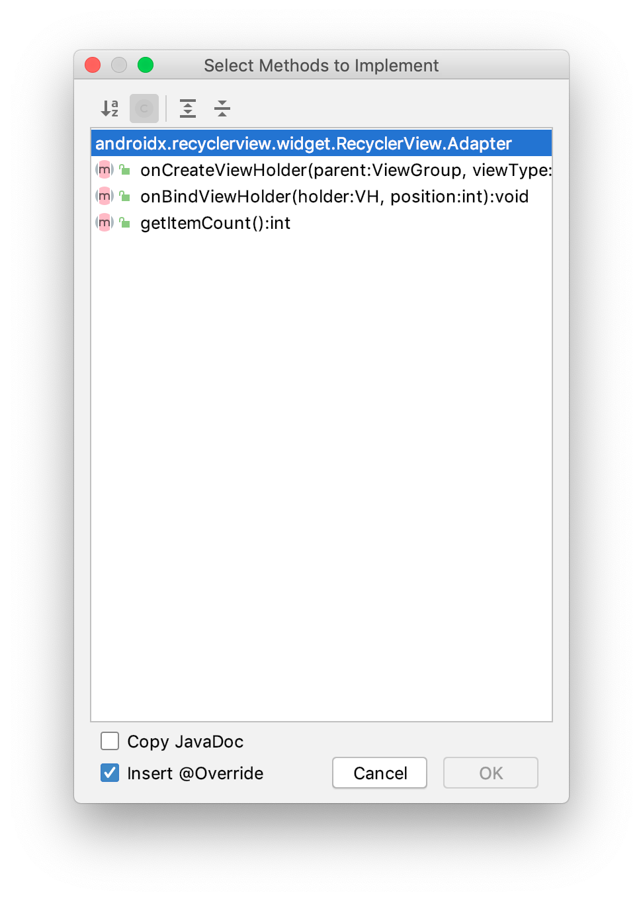
Steps
Create a new class
The class needs to extend the Adapter
RecyclerView Adapter

Slide 73
Steps
Create a new class
The class needs to extend the Adapter
RecyclerView Adapter

Slide 74
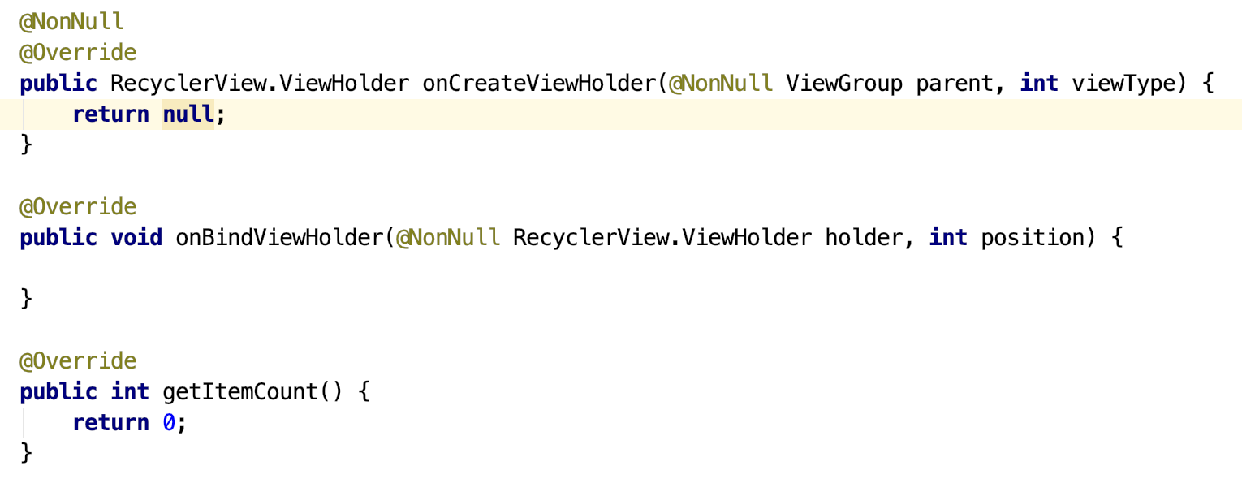
Steps
Create a new class
The class needs to extend the Adapter
RecyclerView Adapter

Slide 75
Steps
Create a new class
The class needs to extend the Adapter
RecyclerView Adapter

Slide 76
Steps
Create a new class
The class needs to extend the Adapter
RecyclerView Adapter
Create a new ViewHolder

Slide 77
RecyclerView Adapter
Steps
Create a new class
The class needs to extend the Adapter
Create a new ViewHolder

Slide 78
RecyclerView Adapter
Steps
Create a new class
The class needs to extend the Adapter
Create a new ViewHolder
RecyclerView.Adapter< Specifiy here >

Slide 79
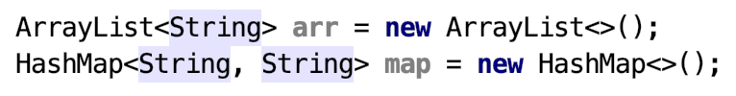
RecyclerView Adapter
Steps
Create a new class
The class needs to extend the Adapter
Create a new ViewHolder
RecyclerView.Adapter< Specifiy here >

Slide 80
RecyclerView Adapter
Steps
Create a new class
The class needs to extend the Adapter
Create a new ViewHolder
RecyclerView.Adapter< TheNewClassName >
It could be any name

Slide 81
RecyclerView Adapter
Steps
Create a new class
The class needs to extend the Adapter
Create a new ViewHolder
RecyclerView.Adapter<Bassam>

Slide 82
RecyclerView Adapter
Steps
Create a new class
The class needs to extend the Adapter
Create a new ViewHolder
RecyclerView.Adapter<Bassam>

Slide 83
RecyclerView Adapter
Steps
Create a new class
The class needs to extend the Adapter
Create a new ViewHolder
RecyclerView.Adapter<MyCustomTableAdapter.Bassam>

Slide 84
RecyclerView Adapter
Steps
Create a new class
The class needs to extend the Adapter
Create a new ViewHolder
RecyclerView.Adapter<MyCustomTableAdapter.Bassam>
RecyclerView.Adapter<MyCustomTableAdapter.MyViewHolder>

Slide 85
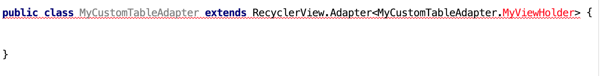
RecyclerView Adapter
Steps
Create a new class
The class needs to extend the Adapter
Create a new ViewHolder

Slide 86
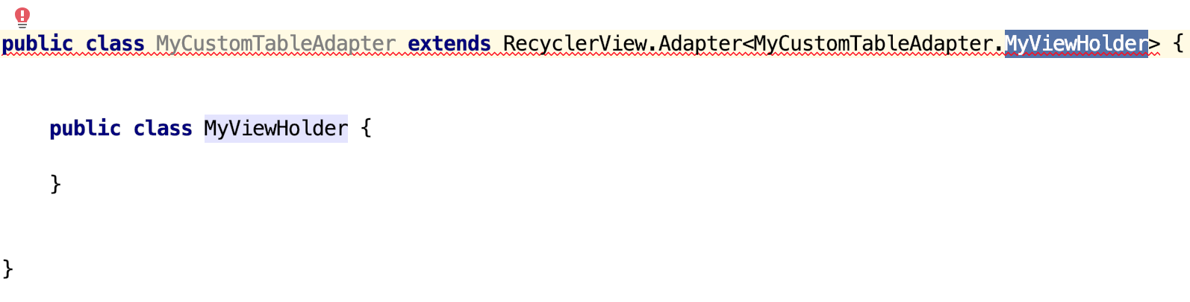
RecyclerView Adapter
Steps
Create a new class
The class needs to extend the Adapter
Create a new ViewHolder

Slide 87
RecyclerView Adapter
Steps
Create a new class
The class needs to extend the Adapter
Create a new ViewHolder

Slide 88
RecyclerView Adapter
Steps
Create a new class
The class needs to extend the Adapter
Create a new ViewHolder

Slide 89
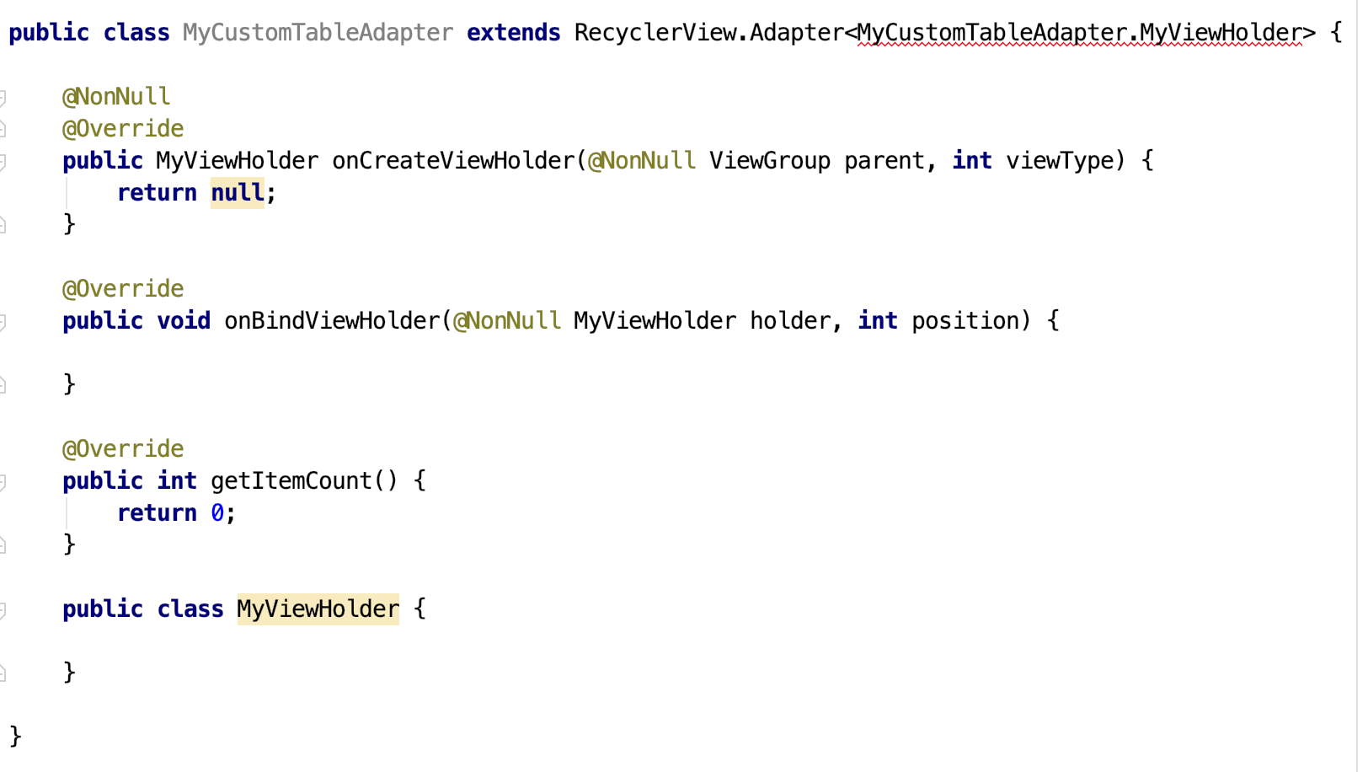
RecyclerView Adapter
Steps
Create a new class
The class needs to extend the Adapter
Create a new ViewHolder

Slide 90
RecyclerView Adapter
Steps
Create a new class
The class needs to extend the Adapter
Create a new ViewHolder

Slide 91
RecyclerView Adapter
Steps
Create a new class
The class needs to extend the Adapter
Create a new ViewHolder

Slide 92
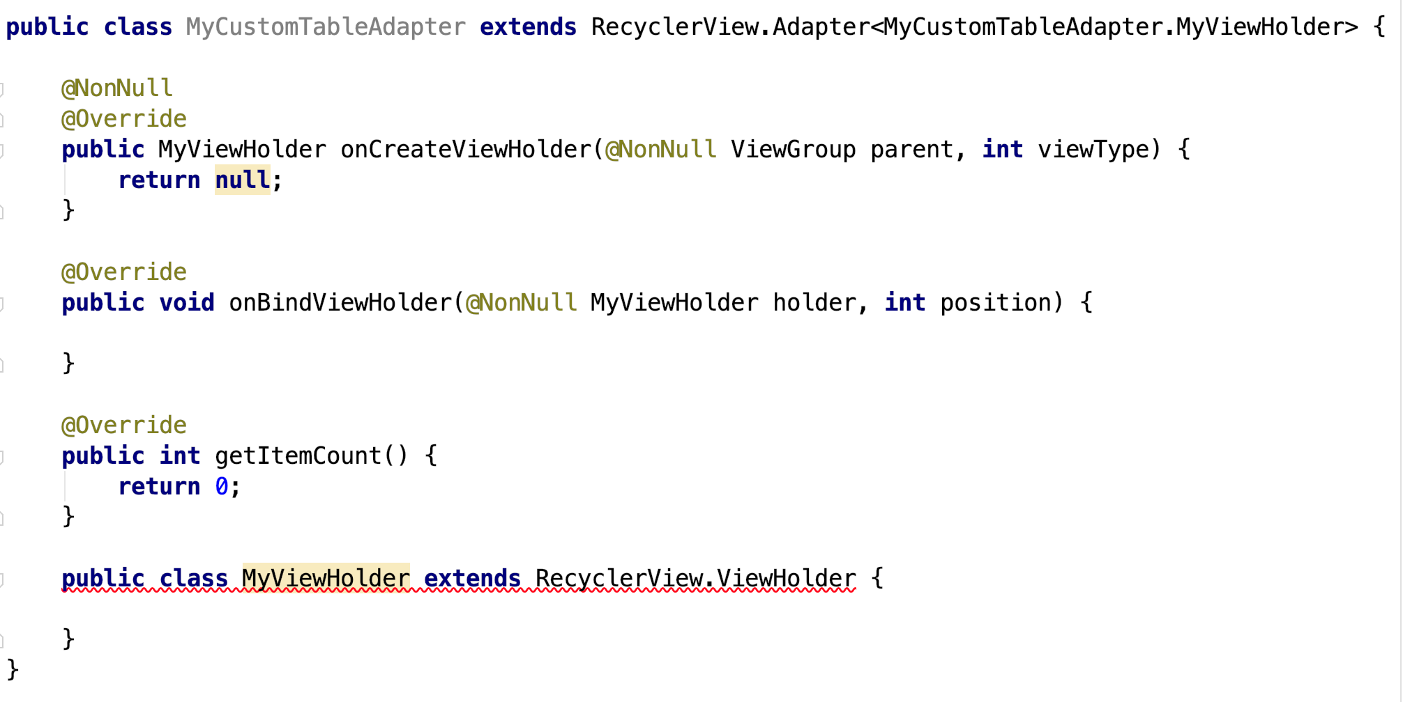
RecyclerView Adapter
Steps
Create a new class
The class needs to extend the Adapter
Create a new ViewHolder
Notes:
Super is used to call parent class methods.

Slide 93
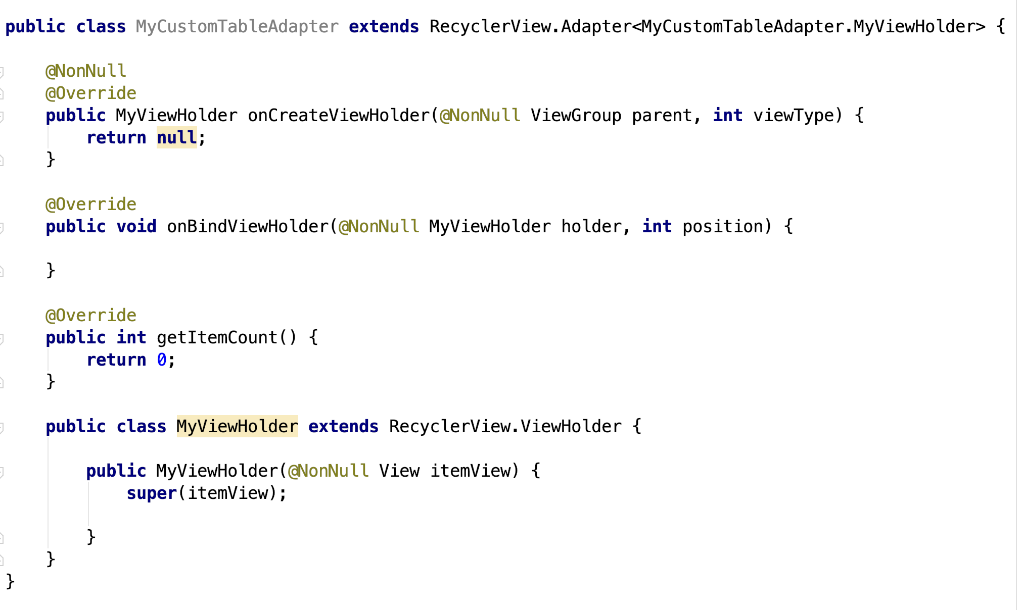
RecyclerView Adapter
Steps
Create a new class
The class needs to extend the Adapter
Create a new ViewHolder
Notes:
Super is used to call parent class methods.

Slide 94
RecyclerView Adapter
Steps
Create a new class
The class needs to extend the Adapter
Create a new ViewHolder
Notes:
Super is used to call parent class methods.

Slide 95
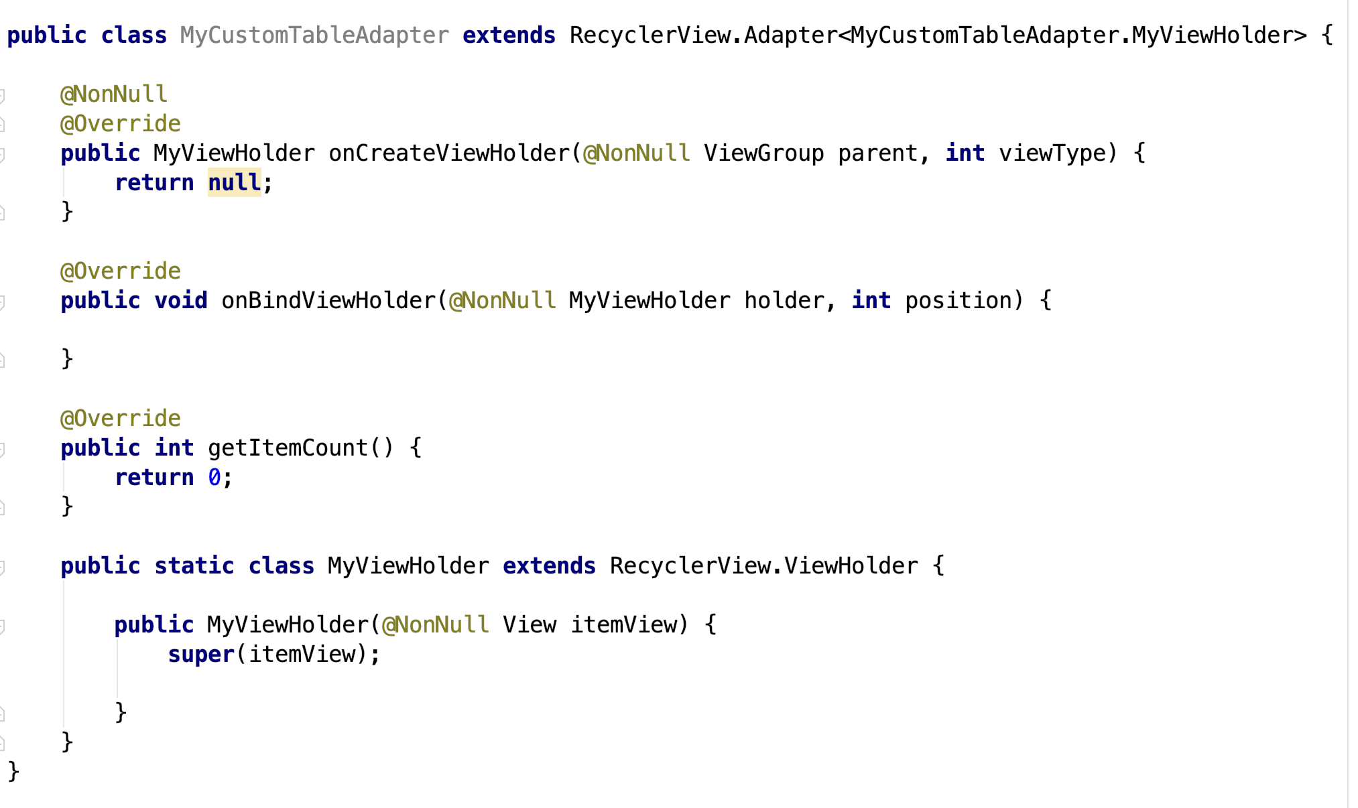
RecyclerView Adapter
Steps
Create a new class
The class needs to extend the Adapter
Create a new ViewHolder
Notes:
Super is used to call parent class methods.

Slide 96
RecyclerView Adapter
Steps
Create a new class
The class needs to extend the Adapter
Create a new ViewHolder
Notes:
Super is used to call parent class methods.

Slide 97
RecyclerView Adapter
Steps
Create a new class
The class needs to extend the Adapter
Create a new ViewHolder
Deal with the Adapter

Slide 98
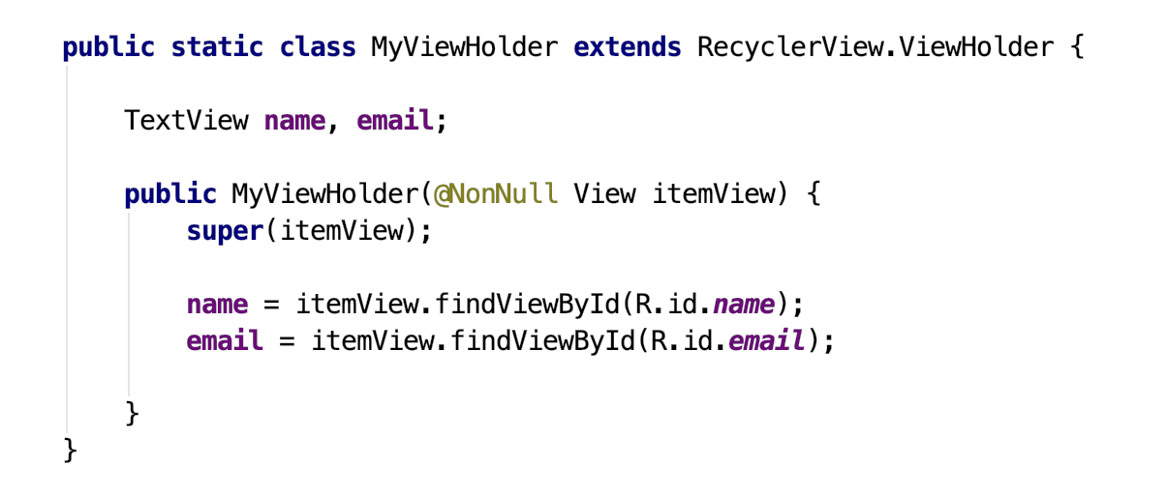
RecyclerView Adapter
Steps
Create a new class
The class needs to extend the Adapter
Create a new ViewHolder
Deal with the Adapter

Slide 99
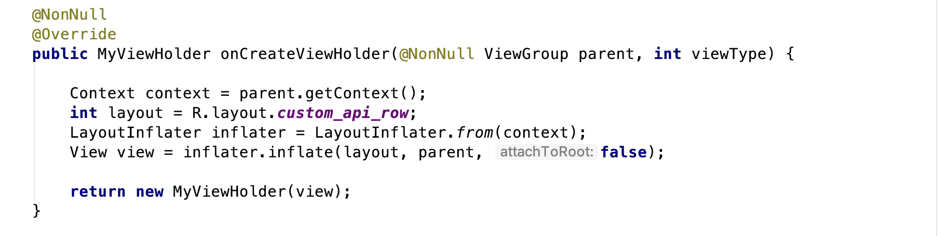
RecyclerView Adapter
Steps
Create a new class
The class needs to extend the Adapter
Create a new ViewHolder
Deal with the Adapter

Slide 100
RecyclerView Adapter
Steps
Create a new class
The class needs to extend the Adapter
Create a new ViewHolder
Deal with the Adapter
To get the activity

Slide 101
RecyclerView Adapter
Steps
Create a new class
The class needs to extend the Adapter
Create a new ViewHolder
Deal with the Adapter
To get the layout

Slide 102
RecyclerView Adapter
Steps
Create a new class
The class needs to extend the Adapter
Create a new ViewHolder
Deal with the Adapter
Step:1
Link the layout with the activity

Slide 103
RecyclerView Adapter
Steps
Create a new class
The class needs to extend the Adapter
Create a new ViewHolder
Deal with the Adapter
Step 2
Link the layout with the activity

Slide 104
RecyclerView Adapter
Steps
Create a new class
The class needs to extend the Adapter
Create a new ViewHolder
Deal with the Adapter

Slide 105
RecyclerView Adapter
Steps
Create a new class
The class needs to extend the Adapter
Create a new ViewHolder
Deal with the Adapter
Give me new view every time I ask

Slide 106
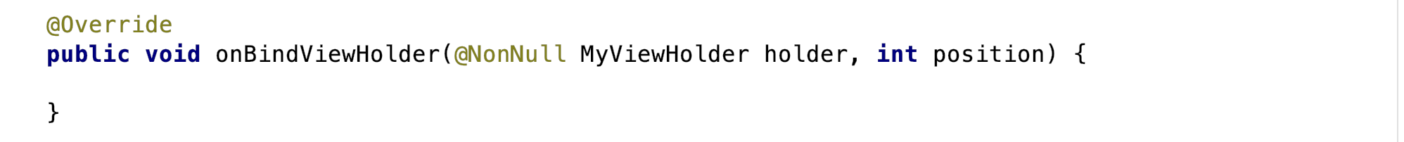
RecyclerView Adapter
Steps
Create a new class
The class needs to extend the Adapter
Create a new ViewHolder
Deal with the Adapter

Slide 107
RecyclerView Adapter
Steps
Create a new class
The class needs to extend the Adapter
Create a new ViewHolder
Deal with the Adapter
We need to access the data

Slide 108
RecyclerView Adapter
Steps
Create a new class
The class needs to extend the Adapter
Create a new ViewHolder
Deal with the Adapter
We need to access the data
In Slide 53, I said we use Model class to send / receive data.

Slide 109
RecyclerView Adapter
Steps
Create a new class
The class needs to extend the Adapter
Create a new ViewHolder
Deal with the Adapter
We need to access the data
In Slide 53, I said we use Model class to send / receive data.
So, let’s do it.

Slide 110
RecyclerView Adapter
Steps
Create a new class
The class needs to extend the Adapter
Create a new ViewHolder
Deal with the Adapter
Since we are dealing with list of names and emails, we should create one.

Slide 111
RecyclerView Adapter
Steps
Create a new class
The class needs to extend the Adapter
Create a new ViewHolder
Deal with the Adapter
Since we are dealing with list of names and emails, we should create one.
List

Slide 112
RecyclerView Adapter
Steps
Create a new class
The class needs to extend the Adapter
Create a new ViewHolder
Deal with the Adapter
Since we are dealing with list of names and emails, we should create one.
Since the data comes through Model Class, I need to specify it.
List

Slide 113
RecyclerView Adapter
Steps
Create a new class
The class needs to extend the Adapter
Create a new ViewHolder
Deal with the Adapter
Since we are dealing with list of names and emails, we should create one.
Since the data comes through Model Class, I need to specify it.
List<MyCustomTable>

Slide 114
RecyclerView Adapter
Steps
Create a new class
The class needs to extend the Adapter
Create a new ViewHolder
Deal with the Adapter
Since we are dealing with list of names and emails, we should create one.
Since the data comes through Model Class, I need to specify it.
Declare a new variable to deal with.
List<MyCustomTable>

Slide 115
RecyclerView Adapter
Steps
Create a new class
The class needs to extend the Adapter
Create a new ViewHolder
Deal with the Adapter
Since we are dealing with list of names and emails, we should create one.
Since the data comes through Model Class, I need to specify it.
Declare a new variable to deal with.
List<MyCustomTable> myList;

Slide 116

RecyclerView Adapter
Steps
Create a new class
The class needs to extend the Adapter
Create a new ViewHolder
Deal with the Adapter
Since we are dealing with list of names and emails, we should create one.
Since the data comes through Model Class, I need to specify it.
Declare a new variable to deal with.

Slide 117
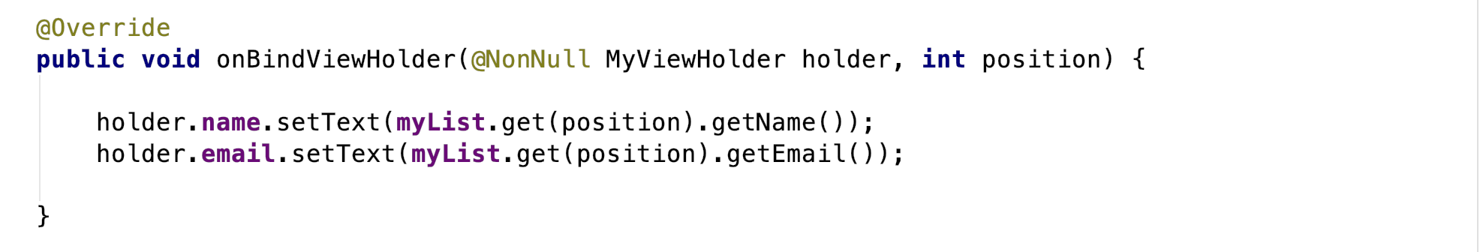
RecyclerView Adapter
Steps
Create a new class
The class needs to extend the Adapter
Create a new ViewHolder
Deal with the Adapter

Slide 118
RecyclerView Adapter
Steps
Create a new class
The class needs to extend the Adapter
Create a new ViewHolder
Deal with the Adapter
To access the view holder

Slide 119
RecyclerView Adapter
Steps
Create a new class
The class needs to extend the Adapter
Create a new ViewHolder
Deal with the Adapter
Select the view you want from the view holder

Slide 120
RecyclerView Adapter
Steps
Create a new class
The class needs to extend the Adapter
Create a new ViewHolder
Deal with the Adapter
Select the method we want. In our case, we want to display some texts, so we chose setText()

Slide 121
RecyclerView Adapter
Steps
Create a new class
The class needs to extend the Adapter
Create a new ViewHolder
Deal with the Adapter
From where you want to get the text

Slide 122
RecyclerView Adapter
Steps
Create a new class
The class needs to extend the Adapter
Create a new ViewHolder
Deal with the Adapter
get() method ----> takes position as an argument
position ----> used to specify the position for each item

Slide 123
RecyclerView Adapter
Steps
Create a new class
The class needs to extend the Adapter
Create a new ViewHolder
Deal with the Adapter
To get the data from the Model class

Slide 124
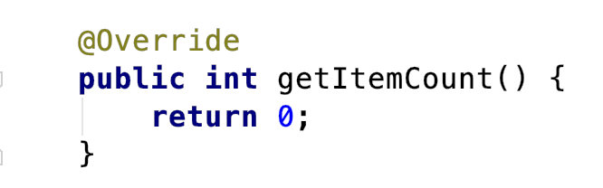
RecyclerView Adapter
Steps
Create a new class
The class needs to extend the Adapter
Create a new ViewHolder
Deal with the Adapter

Slide 125
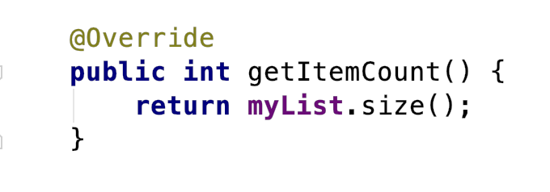
RecyclerView Adapter
Steps
Create a new class
The class needs to extend the Adapter
Create a new ViewHolder
Deal with the Adapter

Slide 126
RecyclerView Adapter
Steps
Create a new class
The class needs to extend the Adapter
Create a new ViewHolder
Deal with the Adapter

Slide 127
MainActivity

Slide 128
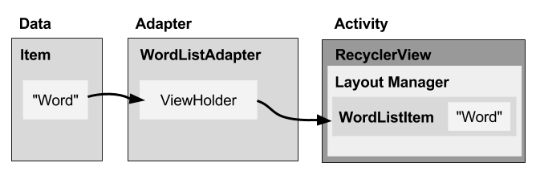
MainActivity

Slide 129
MainActivity

Slide 130
MainActivity

Slide 131
MainActivity

Slide 132
MainActivity
Set the adapter

Slide 133
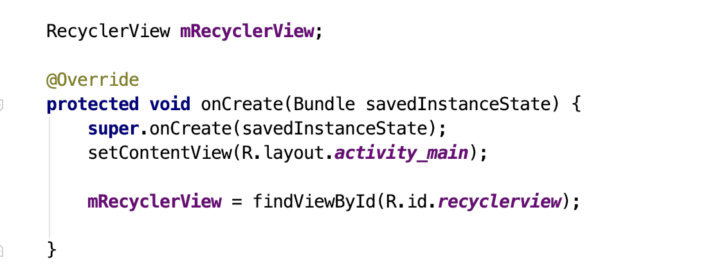
MainActivity

Slide 134
MainActivity

Slide 135
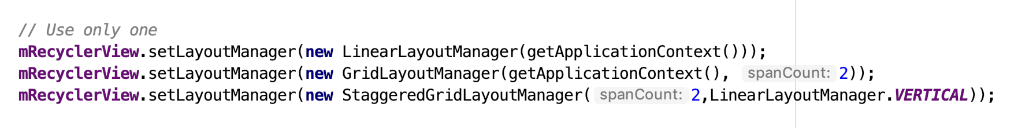
MainActivity

Slide 136
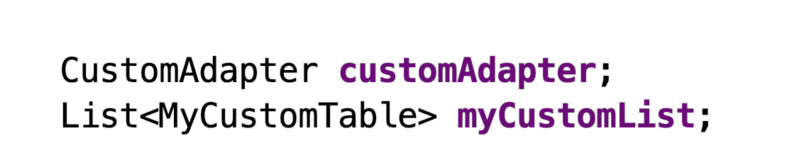
MainActivity

Slide 137
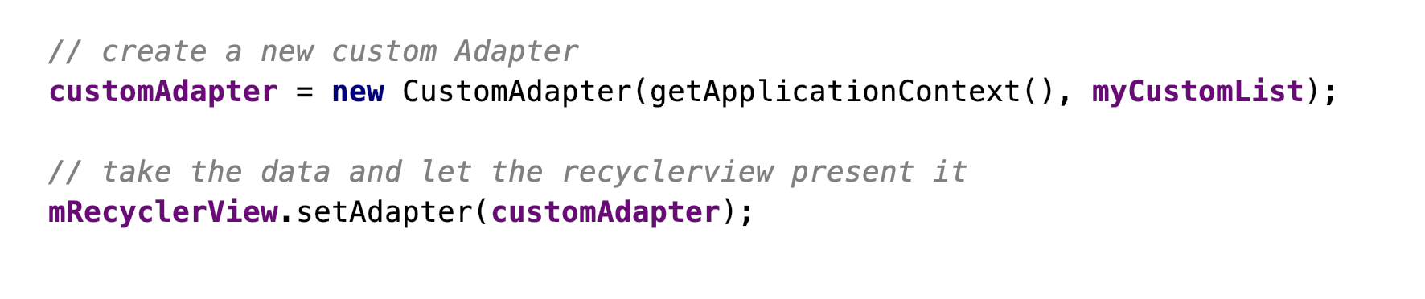
MainActivity

Slide 138
MainActivity

Slide 139
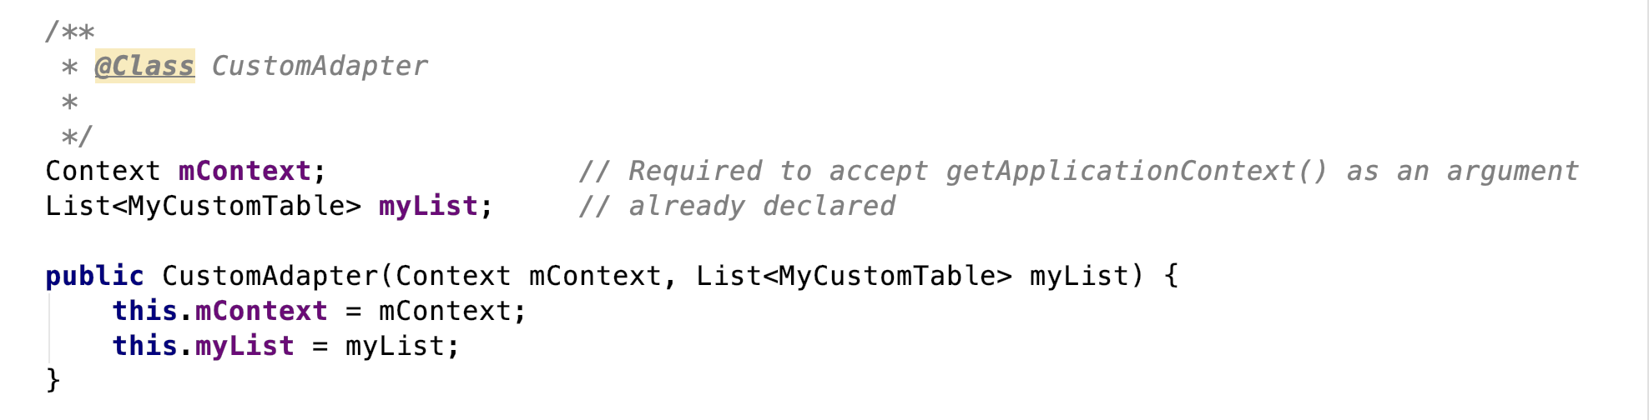
MainActivity

Slide 140
MainActivity

Slide 141
Thanks

